Slide 1
Chapter 17 – Web Security
Notes:
Opening quote.

Slide 2
Web Security
Internet & Web are vulnerable
They have a variety of threats related to
  integrity
  confidentiality
  denial of service
  authentication
They need added security mechanisms
Notes:
The World Wide Web is widely used by businesses, government agencies, and many individuals. But the Internet and the Web are extremely vulnerable to compromises of various sorts, with a range of threats as shown. These can be described as passive attacks including eavesdropping on network traffic between browser and server and gaining access to information on a Web site that is supposed to be restricted, and active attacks including impersonating another user, altering messages in transit between client and server, and altering information on a Web site. The web needs added security mechanisms to address these threats.

Slide 3
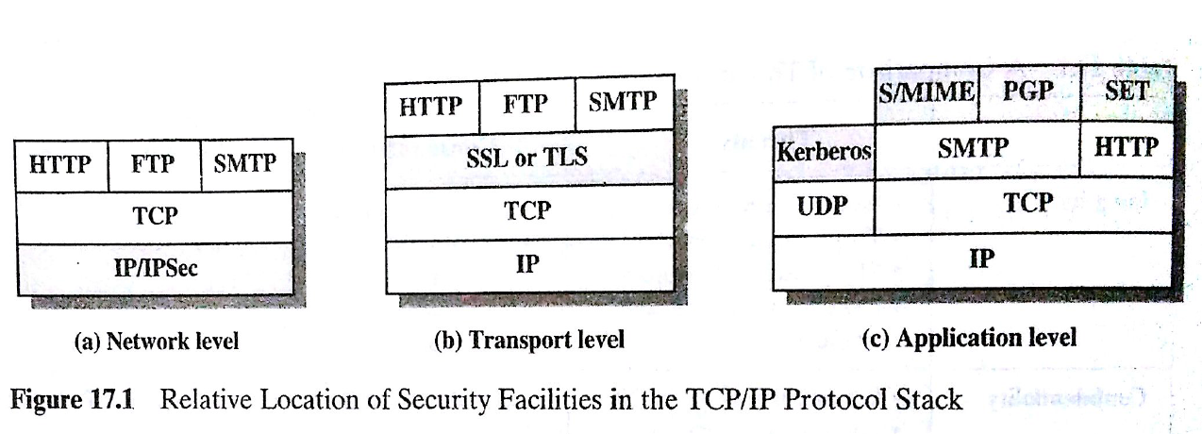

Slide 4
SSL (Secure Socket Layer)
SSL is a transport layer security service
developed by Netscape
Ver 3 was designed with input from public & industry. It subsequently became Internet standard known as TLS (Transport Layer Security)
It uses TCP to provide a reliable end-to-end service
Notes:
SSL probably most widely used Web security mechanism. Its implemented at the Transport layer; cf IPSec at Network layer; or various Application layer mechanisms eg. S/MIME & SET (later).
SSL is designed to make use of TCP to provide a reliable end-to-end secure service. Netscape originated SSL. Version 3 of the protocol was designed with public review and input from industry and was published as an Internet draft document. Subsequently, the IETF TLS working group was formed to develop a common standard. SSL is not a single protocol but rather two layers of protocol, as shown next.

Slide 5
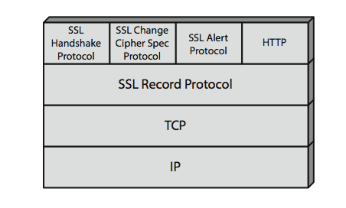
SSL Architecture
SSL has two layers of protocols
Notes:
Stallings Figure 17.2 shows the SSL Protocol stack. The SSL Record Protocol provides basic security services to various higher-layer protocols. In particular, the Hypertext Transfer Protocol (HTTP), which provides the transfer service for Web client/server interaction, can operate on top of SSL. Three higher-layer protocols are also defined as part of SSL: the Handshake Protocol, Change Cipher Spec Protocol, and Alert Protocol. These SSL-specific protocols are used in the management of SSL exchanges.

Slide 6
SSL Architecture
SSL connection
  a transient, peer-to-peer, communications link
  associated with 1 SSL session
SSL session
  an association between client & server
  created by the Handshake Protocol
  define a set of cryptographic parameters
  may be shared by multiple SSL connections
Notes:
Two important SSL concepts are the SSL connection and the SSL session:
• Connection: A connection is a network transport that provides a suitable type of service, such connections are transient, peer-to-peer relationships, associated with one session
• Session: An SSL session is an association between a client and a server, created by the Handshake Protocol. Sessions define a set of cryptographic security parameters, which can be shared among multiple connections. Sessions are used to avoid the expensive negotiation of new security parameters for each connection.

Slide 7
SSL Record Protocol
It provides following two services
message integrity
  using a MAC similar to HMAC but with different padding
confidentiality
  using symmetric encryption:
  AES, IDEA, RC2-40, DES-40, DES, 3DES, Fortezza, RC4-40, RC4-128
Note: 1. Required secret keys are shared by Handshake Protocol
2. message is optionally compressed before encryption
Notes:
SSL Record Protocol defines two services for SSL connections:
• Message Integrity: The Handshake Protocol also defines a shared secret key that is used to form a message authentication code (MAC), which is similar to HMAC
• Confidentiality: The Handshake Protocol defines a shared secret key that is used for conventional encryption of SSL payloads. The message is compressed before being concatenated with the MAC and encrypted, with a range of ciphers being supported as shown.

Slide 8
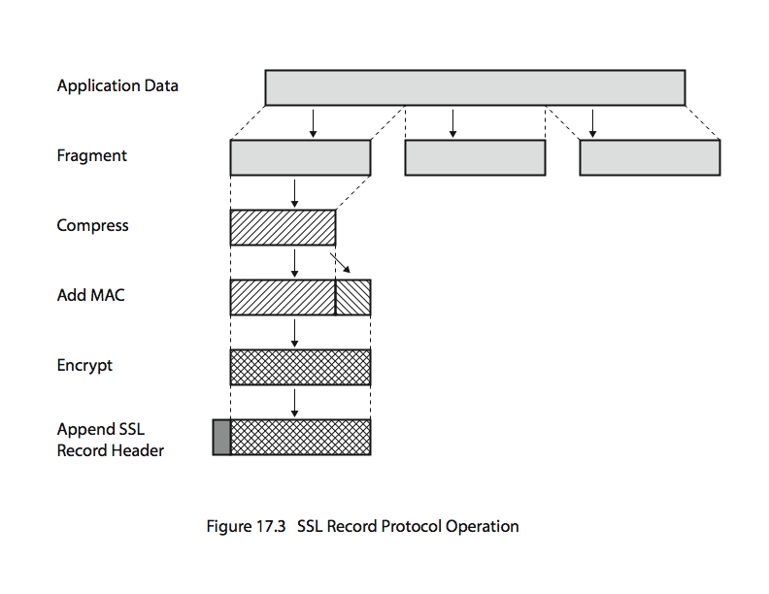
SSL Record Protocol Operation
Optionall
Notes:
Stallings Figure17.3 shows the overall operation of the SSL Record Protocol. The Record Protocol takes an application message to be transmitted, fragments the data into manageable blocks, optionally compresses the data, applies a MAC, encrypts, adds a header, and transmits the resulting unit in a TCP segment. Received data are decrypted, verified, decompressed, and reassembled and then delivered to higher-layer applications.

Slide 9
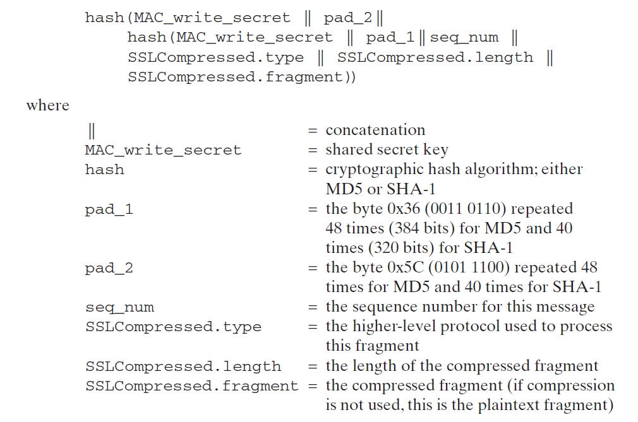
Generation MAC (similar to HMAC

Slide 10
SSL Record Header has following fields:
  Content Type( 8 bits): Change cipher Spec / alert / handshake / application data
  Major Version (8 bits) Eg: In Ver 3.1, major 3
  Minor Version (8 bits) eg., minor is 1
  Compressed Length (16 bits)

Slide 11
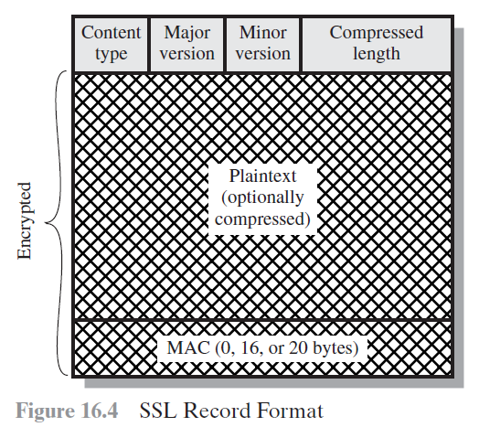

Slide 12

SSL Change Cipher Spec Protocol
It has a single message
causes pending state to be copied to current state
hence updates the cipher suite in use
Notes:
The Change Cipher Spec Protocol is one of the three SSL-specific protocols that use the SSL Record Protocol, and it is the simplest, consisting of a single message. Its purpose is to cause the pending state to be copied into the current state, which updates the cipher suite to be used on this connection.

Slide 13
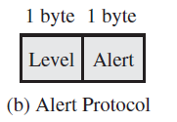
SSL Alert Protocol
conveys SSL-related alerts to peer entity
SSL alert messages are compressed & encrypted
Alert message consists of two bytes:
1st byte indicates severity of msg as: fatal / warning
2nd byte specifies type of alert as:
    In fatal: unexpected message, bad record mac, decompression failure, handshake failure, illegal parameter
    In warning: close notify, no certificate, bad certificate, unsupported certificate, certificate revoked, certificate expired, certificate unknown
Notes:
The Alert Protocol is used to convey SSL-related alerts to the peer entity. As with other applications that use SSL, alert messages are compressed and encrypted, as specified by the current state.
Each message in this protocol consists of two bytes, the first takes the value warning(1) or fatal(2) to convey the severity of the message. The second byte contains a code that indicates the specific alert. The first group shown are the fatal alerts, the others are warnings.

Slide 14
SSL Handshake Protocol
allows server & client to:
  authenticate each other
  to negotiate encryption & MAC algorithms
  to negotiate cryptographic keys to be used
comprises a series of messages in phases
  Establish Security Capabilities
  Server Authentication and Key Exchange
  Client Authentication and Key Exchange
  Finish
Notes:
The most complex part of SSL is the Handshake Protocol. This protocol allows the server and client to authenticate each other and to negotiate an encryption and MAC algorithm and cryptographic keys to be used to protect data sent in an SSL record. The Handshake Protocol is used before any application data is transmitted. The Handshake Protocol consists of a series of messages exchanged by client and server, which can be viewed in 4 phases:
Phase 1. Establish Security Capabilities - this phase is used by the client to initiate a logical connection and to establish the security capabilities that will be associated with it
Phase 2. Server Authentication and Key Exchange - the server begins this phase by sending its certificate if it needs to be authenticated.
Phase 3. Client Authentication and Key Exchange - the client should verify that the server provided a valid certificate if required and check that the server_hello parameters are acceptable
Phase 4. Finish - this phase completes the setting up of a secure connection. The client sends a change_cipher_spec message and copies the pending CipherSpec into the current CipherSpec

Slide 15
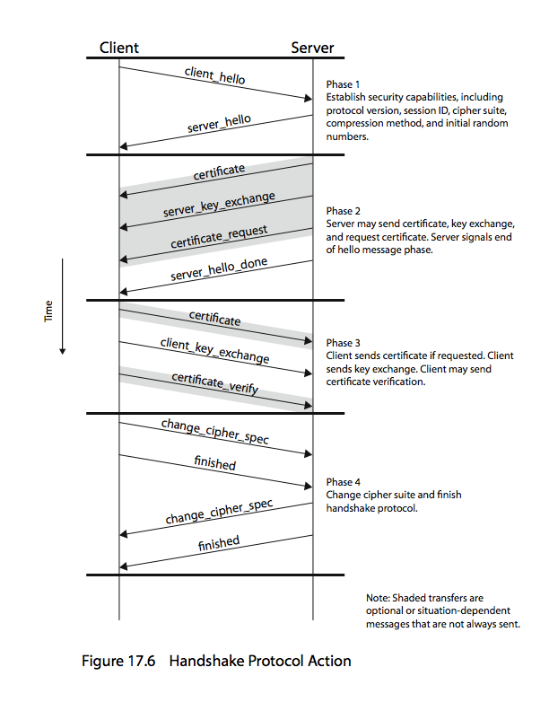
SSL Handshake Protocol
Notes:
Stallings Figure17.6 shows the initial exchange needed to establish a logical connection between client and server. The exchange can be viewed as having the four phases discussed previously.

Slide 16
TLS (Transport Layer Security)
Similar to SSLv3
with minor differences
  in record format version number
  uses HMAC for MAC
  a pseudo-random function expands secrets
  has additional alert codes
  some changes in supported ciphers
  changes in certificate types & negotiations
  changes in crypto computations & padding
Notes:
TLS is an IETF standardization initiative whose goal is to produce an Internet standard version of SSL. TLS is defined as a Proposed Internet Standard in RFC 2246. RFC 2246 is very similar to SSLv3, but with a number of minor differences in the areas shown, as discussed in the text.

